Slide 1
Eco-Routing using OSMNX
Group Members :-
Aman gupta(1801cs05)
Sushant kumar Bharti(1801cs56)
Abhay singh(1801cs66)

Slide 2
Introduction
OSMnx is a Python package that lets you download spatial geometries and model, project, visualize, and analyze street networks from OpenStreetMap's APIs. Users can download and model walkable, drivable, or bikable urban networks with a single line of Python code, and then easily analyze and visualize them.
OSMnx is built on top of geopandas, networkx, and matplotlib and works with OpenStreetMap's APIs.

Slide 3
What we can do with OSMNX ?
Download street networks anywhere in the world with a single line of code.
Download by city name, polygon, bounding box, or point/address + network distance.
Plot figure-ground diagrams of street networks and/or building footprints.
Download drivable, walkable, bikeable, or all street networks.
Save networks to disk as shapefiles.
Calculate and plot shortest-path routes as a static image.

Slide 4
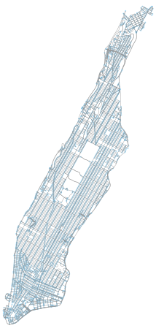
How to use OSMNX ?
import osmnx as ox
G = ox.graph_from_place('Manhattan Island, New York City, New York, USA', network_type='drive’)
ox.plot_graph(G)

Slide 5
Lab Project:-Routing Optimization of Electric Vehicles in Networks with Charging Nodes
Objective:-
1. If the vehicle can not reach its desired destination from the given source with current battery, the program should determine the transit node at which the charging should be done so as to reach the desired destination.
2. Along with the transit, the user should also know how much time would be spent travelling and how much time would be spent charging his/ her vehicle.
3. If the vehicle can reach its desired destination from the given source with current battery, there would be no transit.
4. Since there is no restriction on the number of requests, the routing should be done in such a way that the overall time ( which includes travelling and recharging time ) for all the vehicles should be reduced.
5. If the vehicle does not have enough battery to move from its source to any other transit towards its destination, there should be an option to charge it at the source as well

Slide 6
What we have done so far ?
We have taken a particular location on the basis of longitude, latitude and radius.
We have extracted graph of that location using osmnx.
From that graph we have extracted nodes and edges with distance as their weight.
We have saved all these data to a .txt file.
Now we are taking input from user which include two nodes and available charge in their EV.
Now we have modified our .txt file with the data from user.
We are running algorithms on .txt file to find the possible outcome.

Slide 7
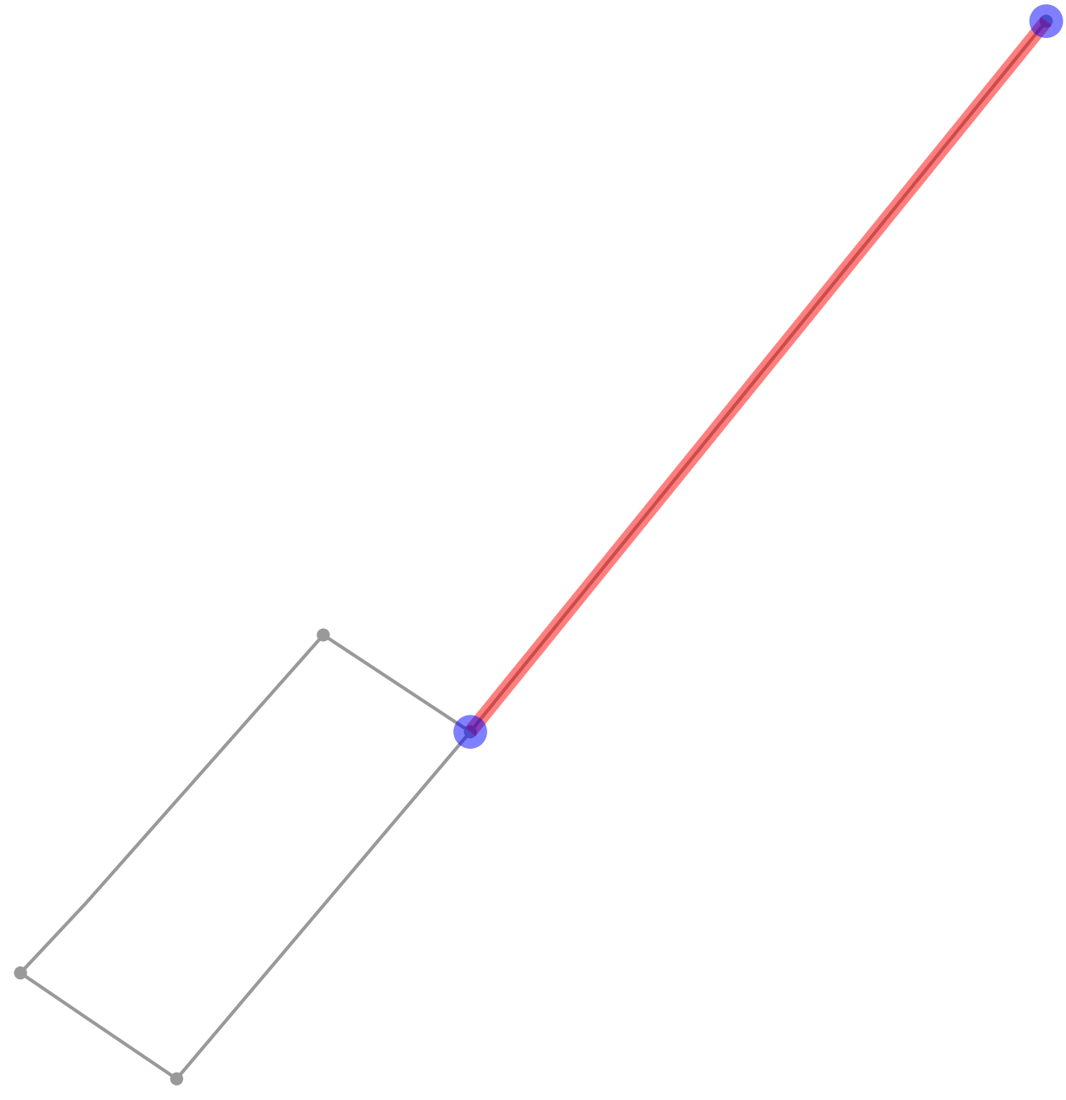
Eco-Routing: 1.When the vehicle can reach from source to destination directly.

Slide 8
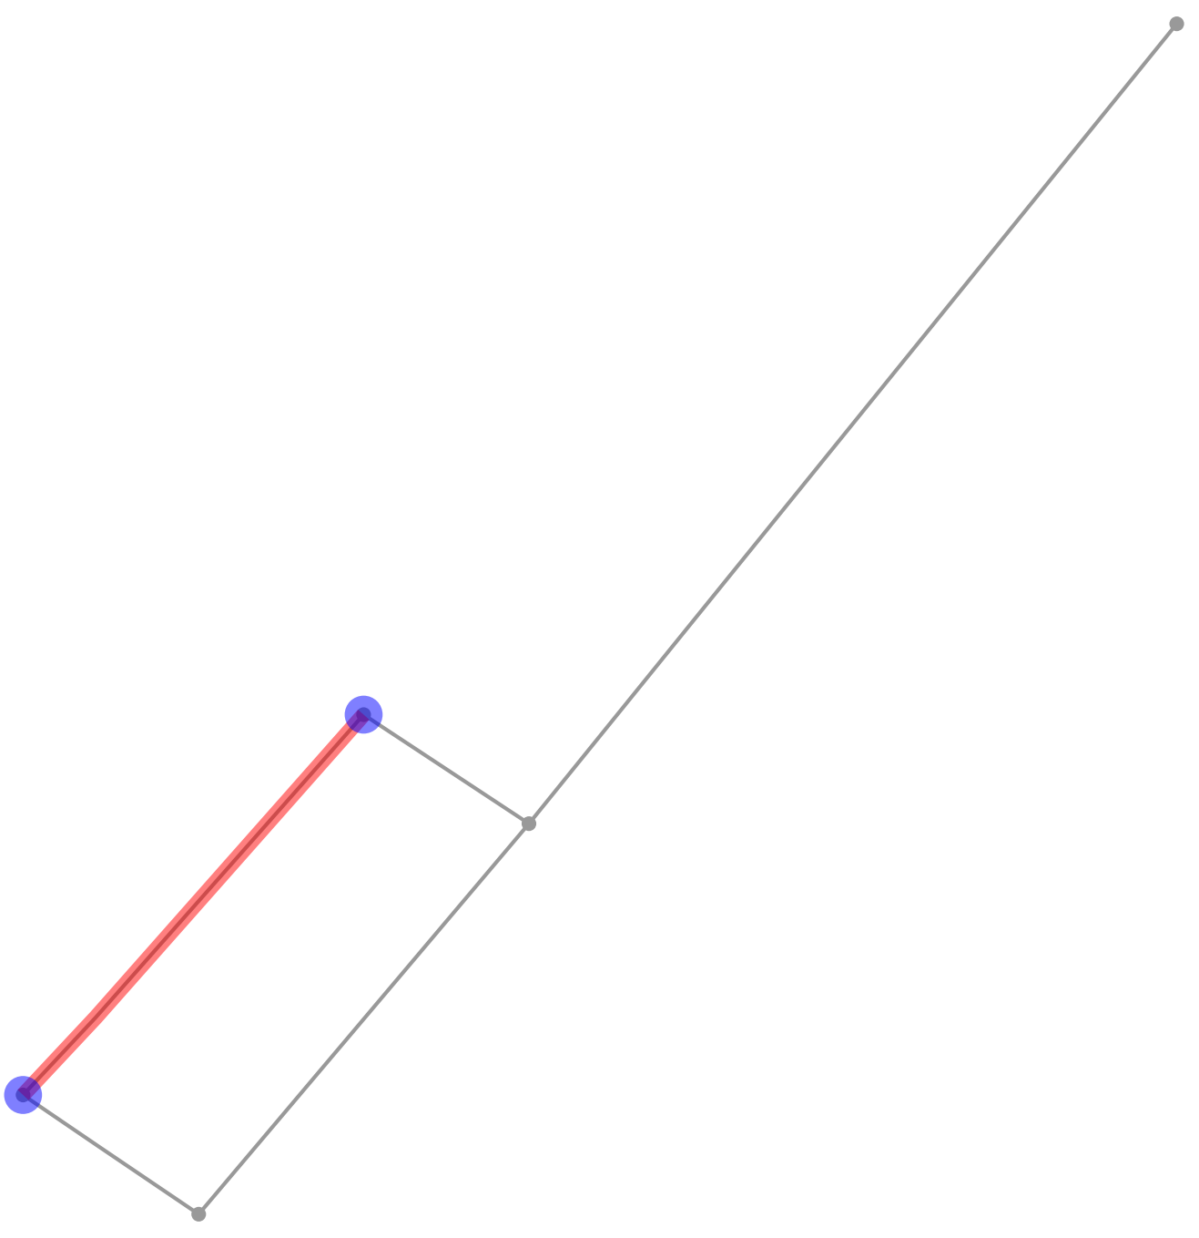
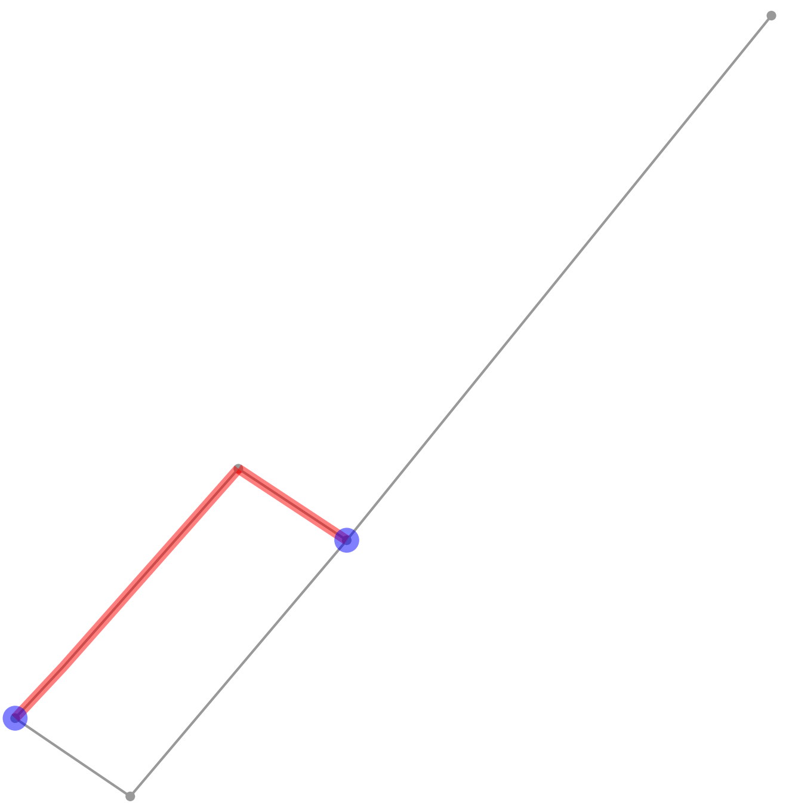
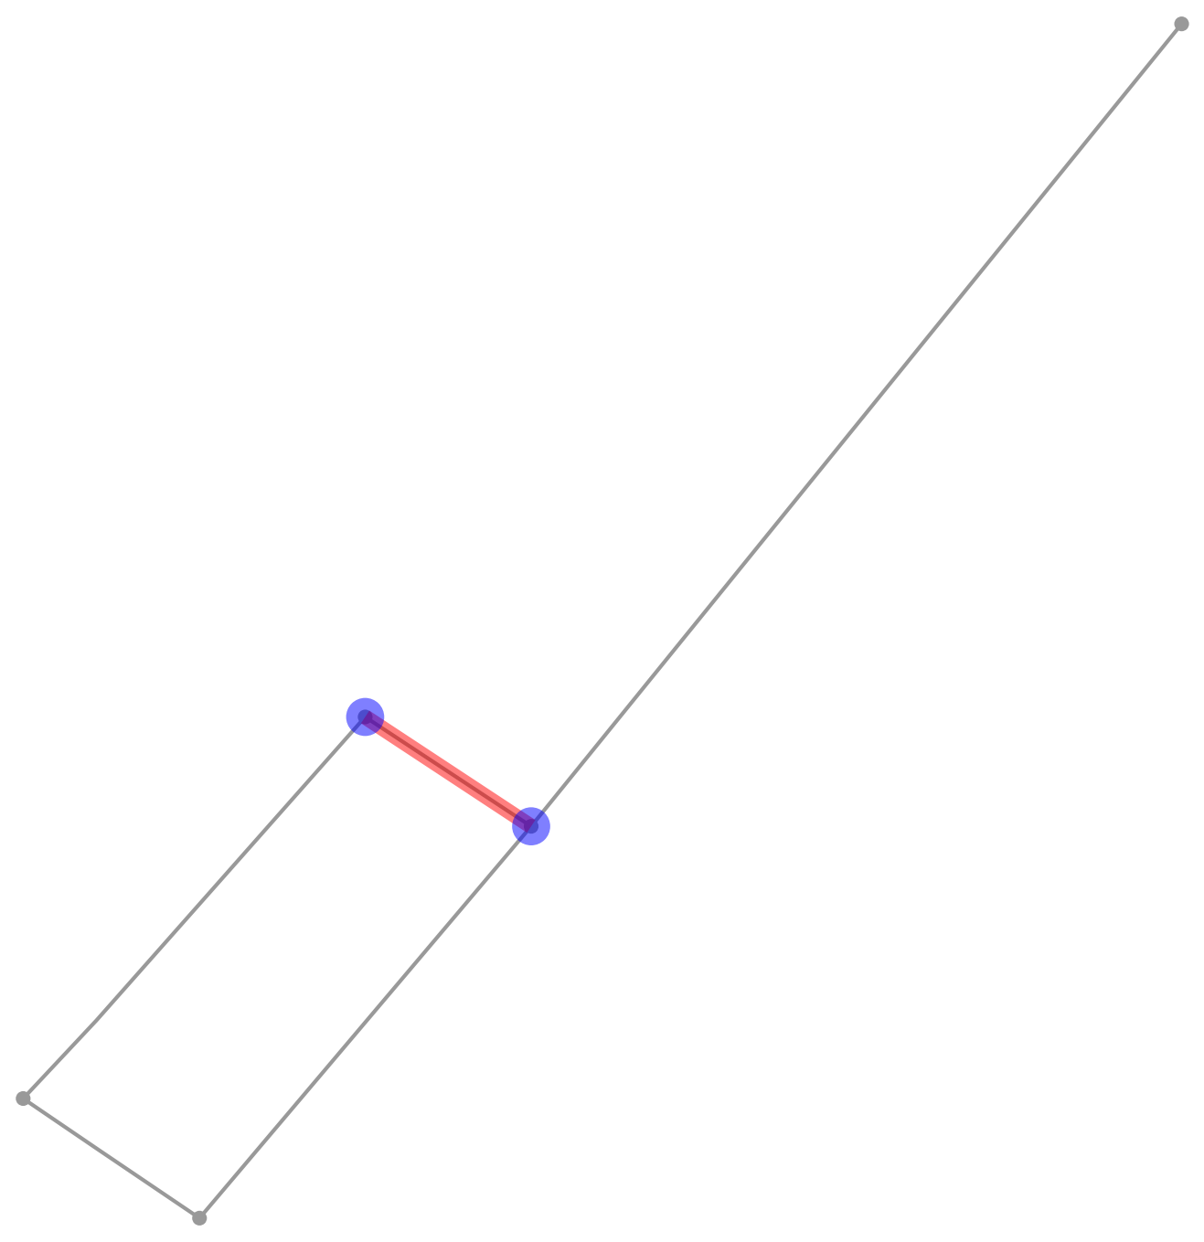
2.From Source to Transit, Transit to destination, and final overall shortest path in shortest time.

Slide 9
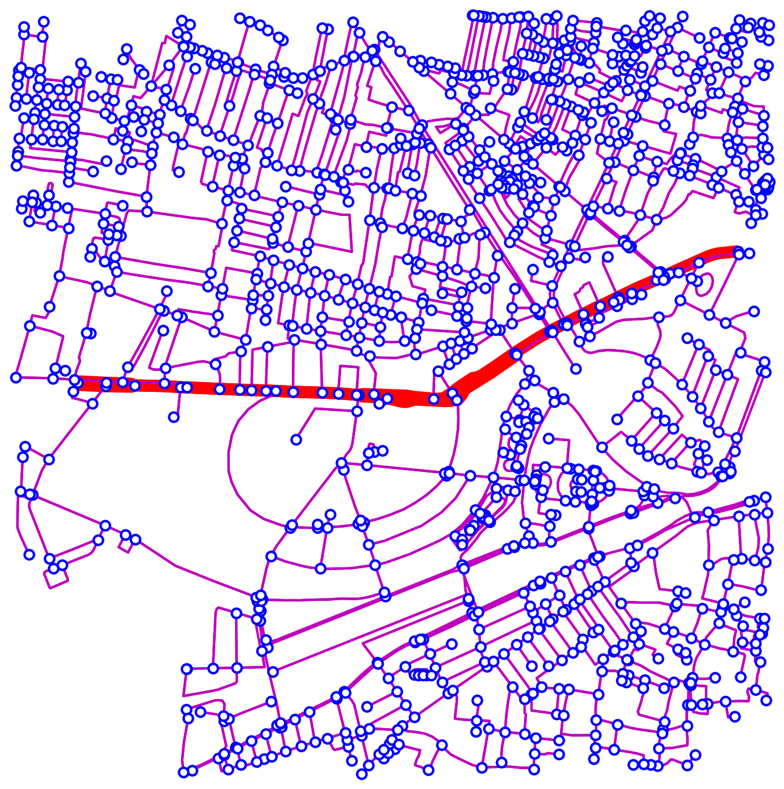
Our earlier experiences.
1. Projecting a particular road on a given map. (e.g:- Bailey Road in Patna)

Slide 10
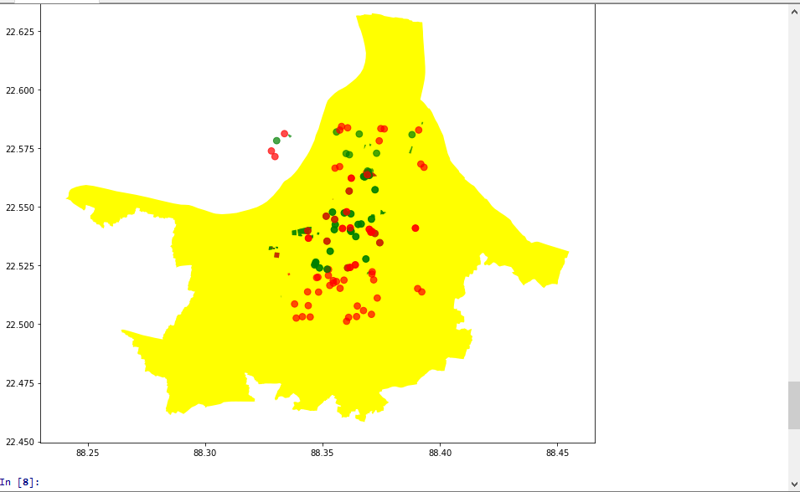
2. Showing POI (point of interest) on a particular graph.

Slide 11
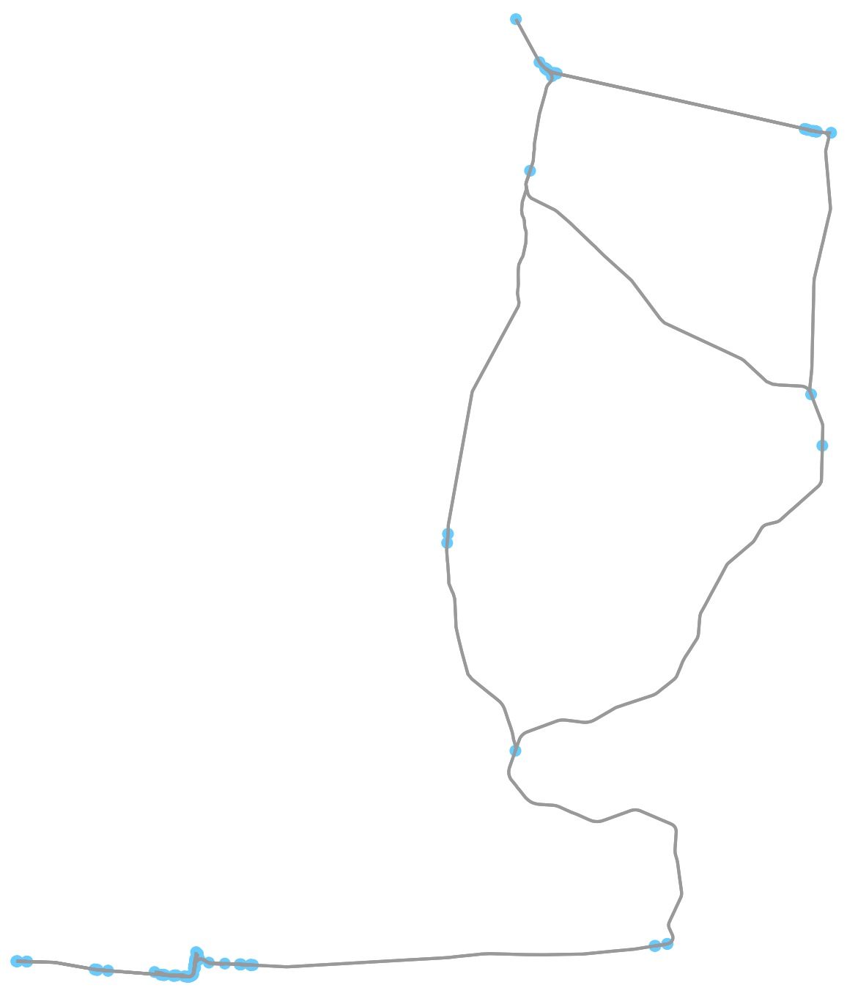
3. Displaying a network of a particular location. (e.g:- Railway, drive and walkable networks.)

Slide 12
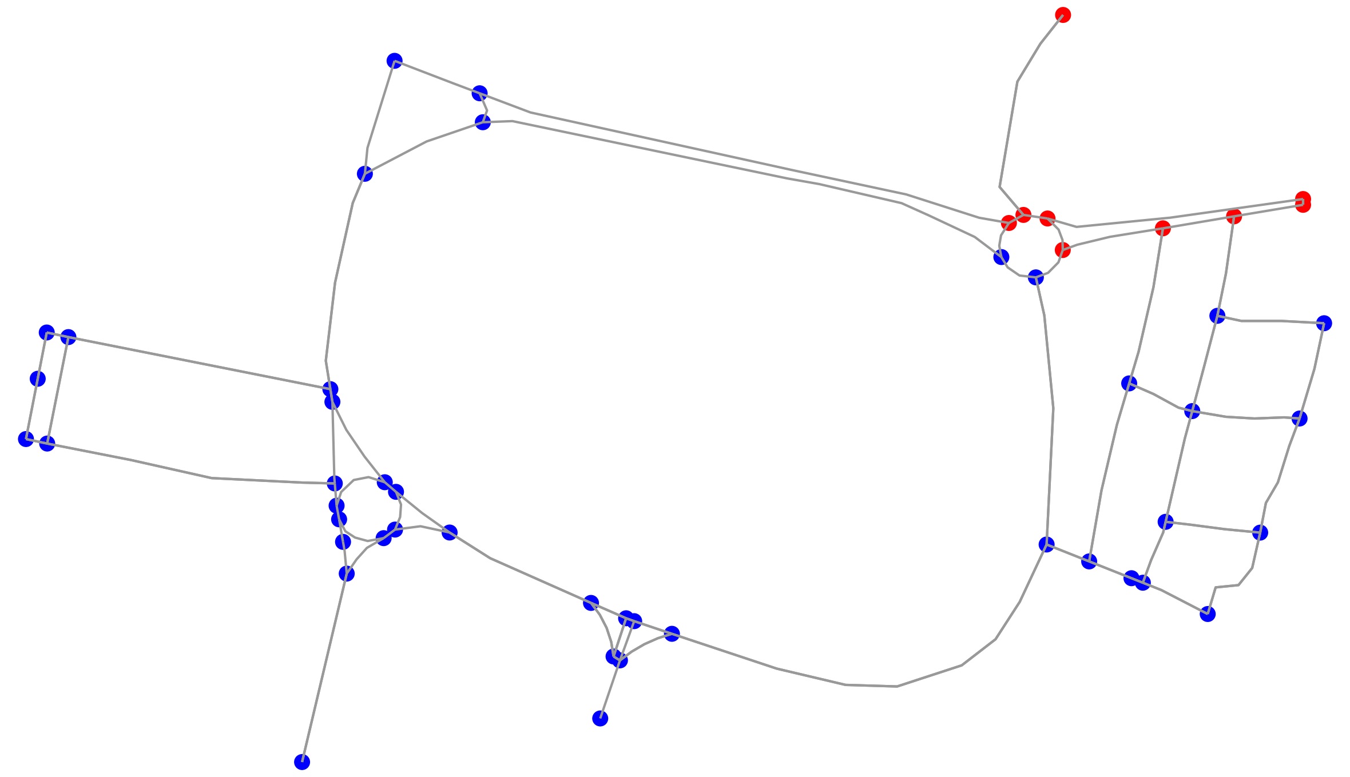
4. Showing the temperature variation of a given location.

Slide 13
Future Work:-
Optimization of algorithm we are going to work.
Preparing interface.
Further exploring Osmnx.
We will try to update information of IIT Patna on OSM.

Slide 14
Learnings:-
Learnt some applications of Osmnx.
Used it for eco-routing in context to Electric Vehicle.

